Slide 1
Data science project Lung Cancer and air Pollution
BY: David Benami
Ohad Bokin

Slide 2
Our research
Research questions:
Is there a connection between an increase in air pollution and morbidity in lung cancer between 2010-2018?

Slide 3
Our sources
Build DataFrames
We took build DataFrames from the “Ministry of Environmental Protection Israel” and "Ministry of Health Israel" websites
Links:
https://www.svivaaqm.net/
https://statistics.health.gov.il/views/_5/sheet0?:embed=y

Slide 4
DataFrames explanation
The Ministry of Environmental Protection Israel
From the Ministry of Environmental Protection Israel website, We took data from different stations around the country and
categorize our Data by:
Year
Pollutant
Monitoring station
The Ministry of Health Israel
From the Ministry of Health Israel website we take the Cancer registration data and categorize our Data by:
Year
Age Group
Cancer Type

Slide 5
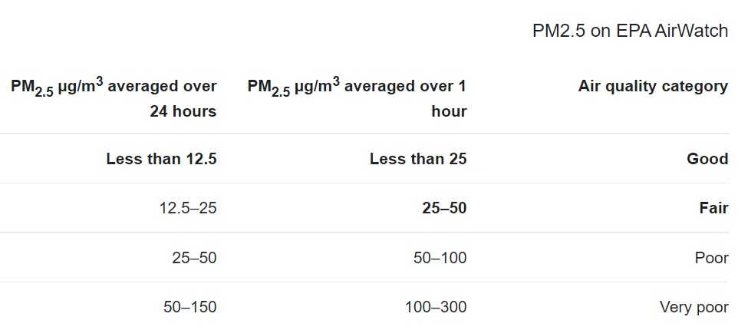
Crawling
We use crawling method for :
To get Data on the Pollutant PM2.5 we use crawling method.
In that method we use the library lxml.htm that we got from
https://towardsdatascience.com/

Slide 6
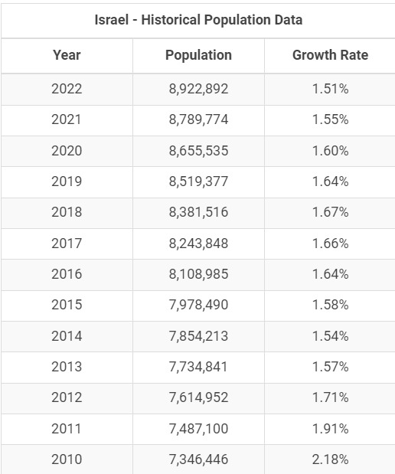
Crawling
To get Data on the Israeli population by year we use BeautifulSoup library https://www.macrotrends.net

Slide 7

Data cleaning

Slide 8
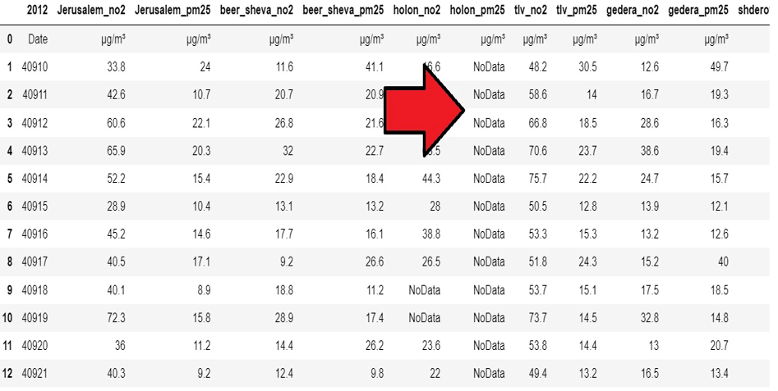
Data Cleaning
In the air monitoring DataFrames most of
the Data is correct and not missing, but in some
columns the Data was missing and appeared
as “NoData”.
After checking with the Ministry of Environmental
Protection Israel, We learned that some of the
Monitoring stations were malfunctioning for
a period of time, and that is why we got
“NoData” some of the times.

Slide 9
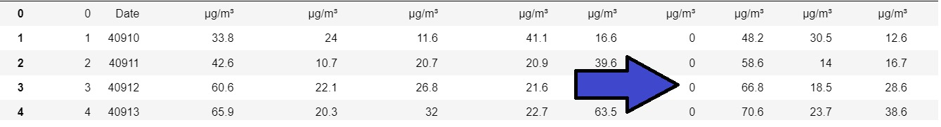
Data Cleaning
We didn’t want to drop any row or column, In order not to
damage the data. And to keep it as a whole year (365 days)
In order to keep it 365 days in a year whenever we found
“NoData” value. We replaced it with number zero.
Both to get rid of the “NoData” value and to have a value
that won’t change the calculation.

Slide 10
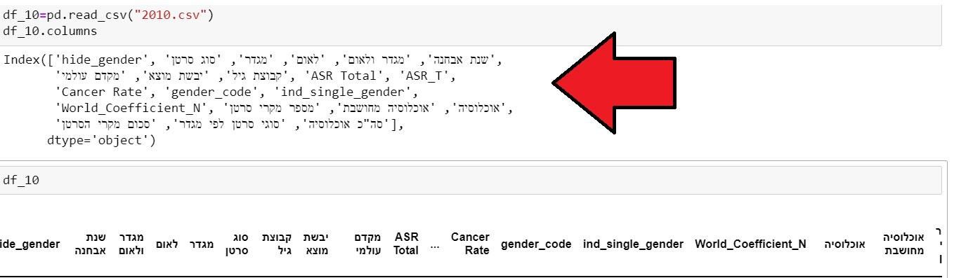
Data Cleaning
In the DataFrames that we downloaded from “Ministry of Health Israel” we had numbers of columns that weren’t relevant to us, or repeating themselves. Also, some of the columns names was in English and some in Hebrew. In that case we had to fix and reorganize it in order to make the Data more readable and understandable.

Slide 11
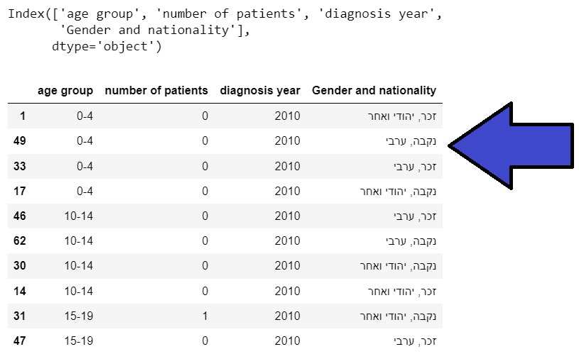
Data Cleaning
First we took only the columns that we needed and are relevant to us.
After that, we change the columns names to more readable names
in English.
In the end we had fixed some of the Data itself and sort it
by the “age group” column.

Slide 12
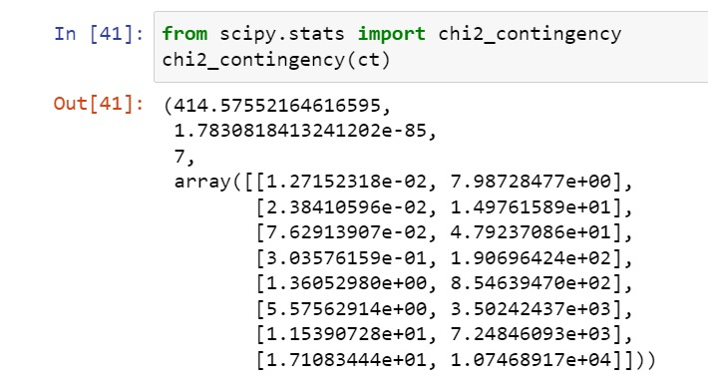
EDA chi square test
We performed chi square test in order to find out if there is a connection between
Age group (that is sorted by decade) and the amount of morbidity.
H0 - Our premise is no connection between the age group and the amount of
morbidity.
H1 - Counter-assumption there is a connection.
Conclusion: Our conclusion from the chi square test that
Our premise is wrong and there is a connection.
(Π is less than 0.5)

Slide 13
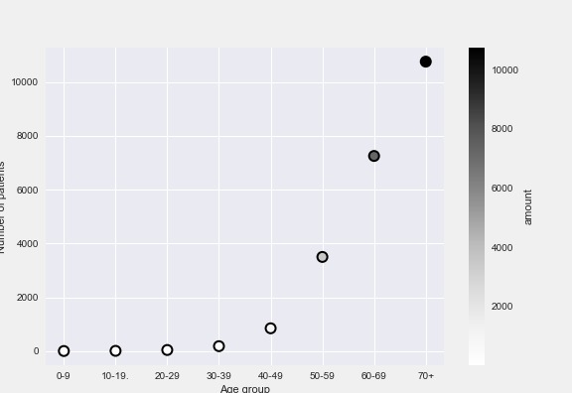
EDA chi square test
We can also see the connection from this scatter plot.

Slide 14
Air pollutants
The main air pollutants we used are PM2.5 and NO2. Because they are the most harmful to lungs
PM2.5 – describes the amount of particulate matter whose aerodynamic diameter is less than 2.5 μm.
Also, particles in the PM2.5 size range are able to travel deeply into the respiratory tract, reaching the lungs.
NO2 – Is short for Nitrogen dioxide, that when inhaled might cause lung irritations and decreased lung function. In areas with higher levels of nitrogen dioxide

Slide 15
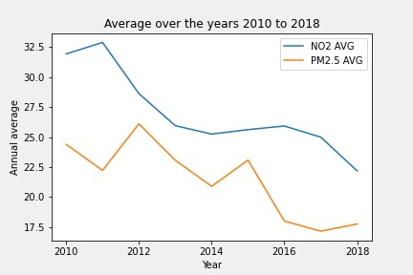
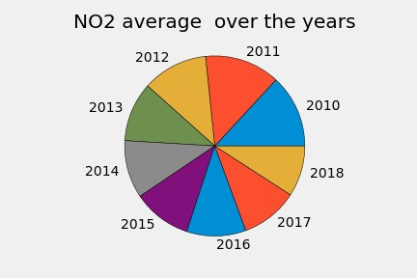
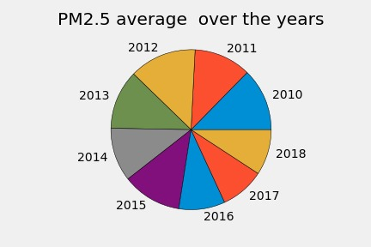
EDA – Pollution growth
The Line chart shows:
The annual average of pollution in PM2.5 and NO2
Between the years 2010 – 2018
NO2 pie chart shows :
The average NO2 pollution each year between 2010 -2018
PM2.5 pie chart:
The average PM2.5 pollution each year between 2010 -2018
Conclusion:
There is a decrease on Air Pollution between 2010 -2018

Slide 16
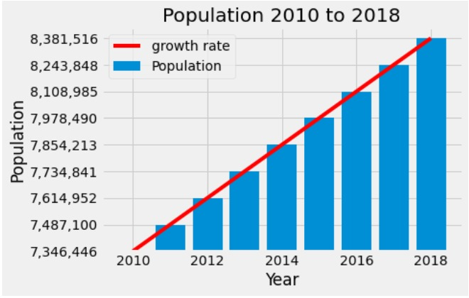
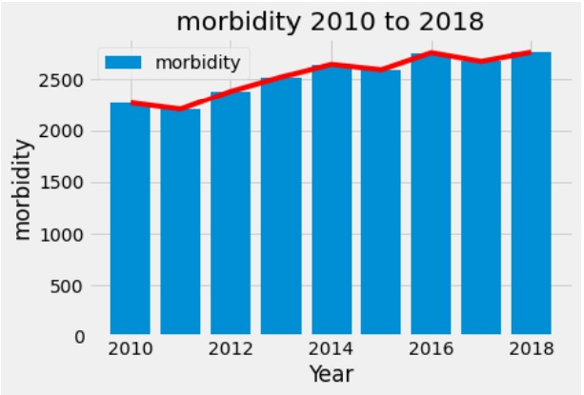
EDA – Population growth & Morbidity
The plot diagram that shows:
population growth In Israel between 2010 – 2018
X-Axis - year
Y-Axis - the number of total population
The Bar diagram that shows:
morbidity growth In Israel between 2010 – 2018
X-Axis - year
Y-Axis - the morbidity and new patients diagnosed per year
Conclusion
The Conclusion is that while the population is growing
Linearly, the morbidity doesn’t change significantly
from each year

Slide 17
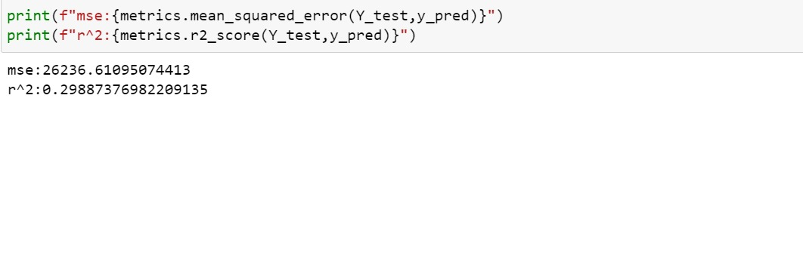
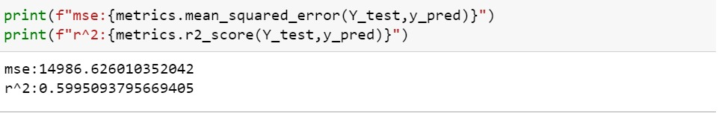
Machine Learning – Linear Regression
Using ‘sklearn’ library and linear regression we were able to train a model that predicts the
the morbidity per the population size
We can see as long the population will grow
The morbidity will grow a long side to it.

Slide 18
Conclusion
In conclusion we learned from our Data, test and plots. There isn’t a connection between air pollution and lung cancer morbidity. We sow that the average rite of PM2.5 and ON2 is decreasing while lung cancer morbidity rite stay the same and even grow.
More over, some factors that can affect our result (like genetics, the advancement of medicine and technology in Israel and around the world) that we didn’t include in our research.

